Slide 1

IMPO
Utility Coordination Whitepaper Presentation

Slide 2
White Paper
Introduction
Background
Moving Forward
Implementation (in development)
Summary

Slide 3
Background
Root causes of delays
Existing Information Inaccurate
Gaps in mapping of new installations
Insufficient communication & Coordination
Differing policies
No oversight or inspections of installations
Lack of strong permitting requirements
Abandoned facilities

Slide 4
Background
Coordination & Communication
Accurate Utility Information During Design and Construction
Lak of Standard Permitting Requirements & Policies

Slide 5
Background
Communication & Coordination
  Changes aren’t communicated in a timely manner
  105 established a coordination process
  Limited to projects administered by INDOT
  Processes and procedures of utility stakeholders need to be considered

Slide 6
Background
Accurate Utility Information During Design & Into Construction
  Construction delays tied to reliability of utility information used during design
  Utilities are not accountable for providing accurate information
  Obtaining accurate information is difficult
  Lack of inspection of relocations

Slide 7
Background
Lack of Standard Policies and Permitting Requirements
  Existing 105 does not include locally funded projects
  Lack of standards for local agencies
  Right-of-way management
  No requirement for as-built data as a permit condition

Slide 8
Moving
Forward
Early utility stakeholder involvement
Digital as-built documentation
Standard ordinances and permit requirements
Utilizing subsurface utility engineering (SUE)
Conducting utility pre-construction meetings
Allowing sufficient time for planning and design
Inspection of utility installations
Communicating short term and long-term improvement projects
Developing utility accommodation policies
Establishing utility coordination councils
Utilizing a risk register or conflict matrix for conflict management

Slide 9
Moving
Forward
The research indicates that EFFECTIVE UTILITY COORDINATION mitigates construction delays.
However, per Julie Johnston of FHWA: “THE EFFECTS OF NOT ACCURATELY LOCATING SUBSURFACE UTILITIES UNDERMINE THE ENTIRE UTILITY COORDINATION PROCESS.”

Slide 10
Moving
Forward
Improved Communication & Engagement
Obtaining accurate utility information through SUE, as-builts, and inspection
Conflict Management
Standardization of policies, procedures, permits

Slide 11
Moving
Forward
Improved Communication & Engagement
  Early Engagement
  Early Coordination Meetings
  Engagement in Design
  Pre-Construction Coordination
  Construction Coordination
  Utility Coordination Councils

Slide 12
Moving
Forward
Obtaining Accurate Utility Information
  SUE in accordance with ASCE 38
  As-Builts and Utility Mapping in accordance with ASCE 75
  Inspection of Utility Installations

Slide 13
Moving
Forward
Conflict Management
  Conflict Matrix during design
  Iterative
  Provided to the Contractor

Slide 14
Moving
Forward
Standardization of Policies, Procedures, and Permits
  Legislation
    DPW’s example, Chapter 645, Article VII
    Boone County Ordinance
  Permits
    General provisions
    Encroachment provisions
  Utility Accommodation Policy
  Utility Coordination Design Processes

Slide 15
Implementation
Develop and/or revise ordinances
  Include language regarding holding or denying permits if permit conditions are not met
Develop standard policies and procedures
  Standardize UAP regionally
  Standardize permit regionally
  Standardize design coordination processes regionally
Hold round tables or forums to communicate changes
  Engage utility stakeholders
  Engage contractors
  Engage consultants

Slide 16
Permitting language does not require a state-level law
Require survey grade, digital as-builts
  Can require specific mapping guidelines, platforms, etc
  X, Y, Z in accordance with ASCE 75
  Include facility information line type, size, material
  Include pictures of connections, appurtenances, etc.
  Abandoned, retired-in-place requirements
Require inspection of utility installations
  For utility-initiated installations – third party inspections
  For project-initiated installations – agency inspections
Develop standard documents
  Utility Accommodation Policy
  Utility Coordination Process for Locally Funded Projects
  Broadband Access Policy
Utilize SUE
  Establish project requirements for when it needs to be utilized
  Doesn’t need to be every project
Utility Coordination Councils
  Open forum for owners & utility stakeholders
  Discuss short range and long range projects
  Collectively discuss changes that can be or need to be made
Require utilities to register with your agency
Implementation
Local Ordinances or Standards

Slide 17
Require as-built mapping at survey grade levels of all new and/or relocated utility installations in accordance with ASCE 75
Develop standard ordinance and permit language within the MPO so utility stakeholders know what to expect within the MPO area –
Require SUE on specific projects
Require inspections of utility installations
Develop a utility coordination council
Develop a State-wide safety commission to review utility damages and impose fines as necessary
Implementation
Policy Recommendations

Slide 18

Questions/Comments
Natalie Parks
natalie.parks@kimley-horn.com
317 526 9045

Slide 20
Literature Review
Indiana Standards – 105 IAC 13, Chapter 104 IDM, UAP
Indiana Code – IC 8, IC 36
SPR 3052 – Best Practices for Utility Management in the Public Right of Way (Draft Report from Iowa State)
NCHRP Synthesis 506 – Effective Utility Coordination
Federal Transit Administration: Utility Relocation – Challenges & Proposed Solutions
Illinois Center for Transportation: Best Management Practices and Incentives to Expedite Utility Relocations
GAO Impacts of Utility Relocations on Highway and Bridge Projects
SCDOT: Impact of Utility Delays on Project Delivery
FHWA: Avoiding Utility Relocations
Colorado Senate Bill 18-167
Minnesota Local Road Research Board: Best Practices for Managing Utility Congestion Within Rights-of-Way
KYTC Integration of Utility Engineering Coordination and Highway Design
2018 FHWA Utility Program Review

Slide 21
SPR 3052
Challenges & Deficiencies
Inconsistent Policies
Permitting & registration requirements
Gaps in as-built data and mapping of new installations
Utility installation guidelines & oversight
Inconsistent use of planning for utility corridors & congested areas
Removal of abandoned/retired facilities
Restoration after installation
Recommendations
Statewide Standardization
Digital as-built documentation
Utility corridor planning
Improved ROW congestion management
Permitting and installation oversight
Restoration standards
Regulation of abandoned, changing utilities

Slide 22
FTA: Utility Relocation – Challenges & Proposed Solutions
Challenges
Agreements
Utility Franchise Agreements
Inaccurate as-builts which lead to underestimating utility relocation impacts to schedule & budget
Probability of finding unknown utilities is high
Lack of defined design & construction expectations
Recommendations
Early identification of utility conflicts
Relocate in joint trenches
Transition coordination to contractor
Utilize a risk register, conflict matrix
Be aware of specific shut down windows
Schedule control & accountability
Field staking prior to construction
Utility investigations
Utility data management

Slide 23
NCHRP Synthesis 506
Top Effective Utility Coordination Practices
Early utility involvement in design
Consideration of utility relocation schedules in relation to project schedule
Utility pre-construction meetings
Defined procedures
Use of standardized agreements
Regularly scheduled meetings with utilties
Use of SUE
Identify and plan for long lead times
Considerations of costs and reimbursements for design/construction versus relocations
Utility conflict matrix tracking system
Training program for design engineers on utility coordination
Utility mapping system
Communication of long-range and short-range transportation plans
Use of utility corridors
Process for utility risk management
Programmatic/system collaborative planning with utilities
Documented guidance on utility conflict resolution methods
Pay for relocations that are traditionally non-reimbursable
Process for safety mitigation in utility coordination

Slide 24
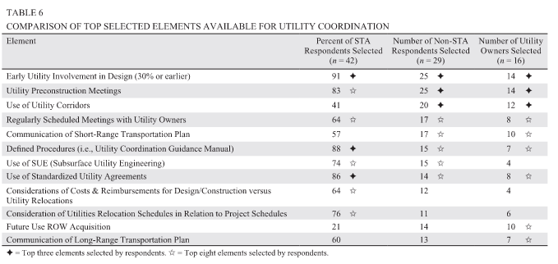
NCHRP Synthesis 506

Slide 25
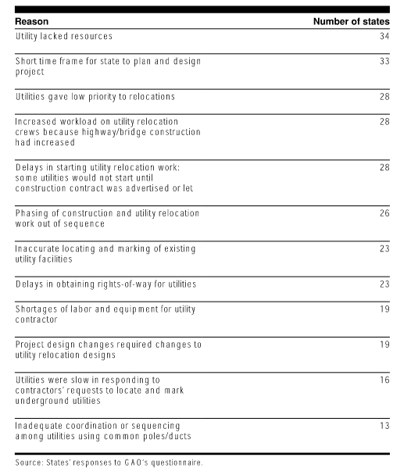
GAO Impacts of Utility Relocations on Highway & Bridge Projects

Slide 26
SCDOT: Impact of Utility Delays on Project Delivery
Risk Factors
Unreliable utility information
Non-responsiveness of utilities
Unknown conflicts
Delays in ROW acquisition
Inaccurate relocations
Late design changes
Interdependencies among utility relocations
Lack of or delay in utilizing SUE
Prior rights
Market conditions
Personnel resources
Inability or lack of information to avoid conflicts in design
Recommendations
Engage Utility owners early
Modify encroachment permit language to include liquidated damages
Sufficient time for planning & relocation
Promote the use of SUE
Effective utility conflict management
Coordinate ROW acquisition with easement needs
Avoid late design changes
Inspect utility installations
Early clearing contracts
Streamline communication

Slide 27
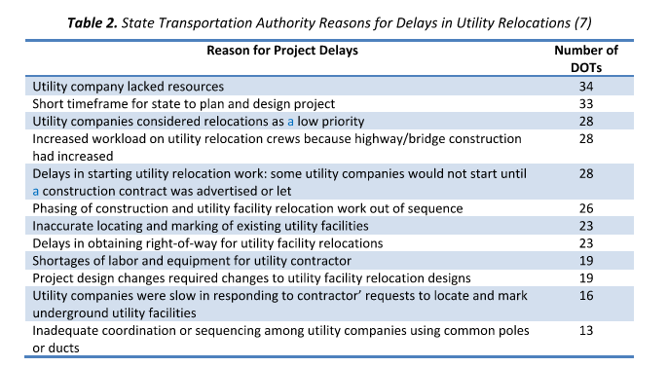
SCDOT Impact of Utility Delays on Project Delivery

Slide 28
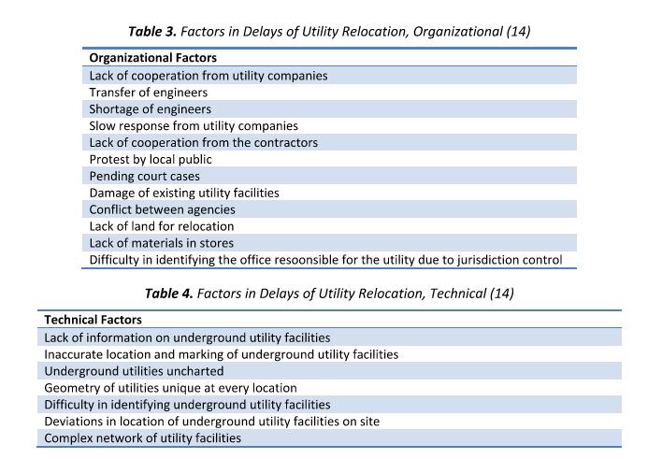
SCDOT Impact of Utility Delays on Project Delivery

Slide 29
2018 FHWA Utility Program Review
Observations
Few States Conduct Accurate Utility Investigations*
Broad Discrepancy on the Use & Content of Utility Agreements*
Do Not Develop Comprehensive Utility Relocation Plans*
Failure to Prepare Utility Relocation Schedules*
Do Not Develop Utility Relocation Cost Estimates
Failure to Include Adequate Utility Information in the Construction Bid Package*
Do Not Know the Cost-and-Time Impacts of Utilities on Construction Projects
Not Performing Quality Assurance on Utility Relocation Work*
Recommendations
Obtain accurate utility location information during the construction phase via SUE
Agreements or work plans should be descriptive with respect to provided utility information
Utility relocation plans should include more accurate information of existing utilities and proposed relocations
Develop an effective relocation schedule that can be integrated into the contractor’s schedule
Incorporate relocations plans, provisions, and schedules into the bid package
Develop Quality assurance programs
*Items that tend to impact utility relocations on locally funded projects and will be further discussed.

Slide 30
2018 FHWA Utility Program Review
Using Utility Investigations
"Contractors, utility owners, and State DOT staff all indicated that as-built location data are unreliable and, at best, may provide a general indication of utility locations in the x and y planes, with no z component or depth. One-Call services generally have a reliability of plus or minus 2 feet on either side of a paint line on the ground. Furthermore, One-Call does not provide depth data. This means that designers are provided only an indication that a utility conflict exists within the design plans.“
Unknown conflicts increase project risk
Inaccurate utility location information in design leads to:
  Increased risk for contractors
  Increased contract bids
  Increased costs due to change orders and delays
  Project delays
  Increased safety risks to contractors and the traveling public because of longer-lasting work zones and the threat of hitting live utility lines.
Recommendations from review:
  Require accurate x-y-z location data via as-builts
  Show accurate utility information in the plans (test holes)

Slide 31
2018 FHWA Utility Program Review
Effective Agreements/Work Plans
Includes a description of the requirements for relocation, construction, protection of traffic, maintenance, access restrictions, special conditions
Includes size, type, nature, and extent of facilities being relocated
Adequate drawings showing existing and proposed locations relative to proposed project improvements
  X-Y-Z locations
  Identification of utility conflicts
  Location of proposed utility installations
  Responsible party for relocating facilities
  Notes regarding special protections
  Plan notes for the contractor
Effective Relocation Plans
Accurate location of existing facilities
Identify utility conflicts
Location of proposed relocations
Notes for facilities remaining in place
Any specific contractor guidance

Slide 32
2018 FHWA Utility Program Review
Adequate Information in the Bid Package
Utility Plans
  Accurate locations
  Identifies utiltiy conflicts with the design
  Indicates final location of proposed relocations
  Indicates who will be performing the utility relocation work
  Special instructions
  Any other utility-related plan notes
Activity Based Schedules
  Preparing the site for utility work
  Advance notice requirements
  Total time to complete relocation work, or a date of anticipated completion
  Contractor restrictions
  Final Inspection
Special Provisions & Plan Notes
  Utility representative contact information
  List of utility conflicts
  Final location of relocated facilities
  Instructions for protect-in-place
  Site specific issues
  Schedule
  Integration of utility schedules into master project shedule
Quality Assurance
Develop a Quality Assurance Plan

Slide 33
Literature Review Summary
Primary Factors Contributing to utility-related delays
Best management practices

Slide 34
LITERATURE REVIEW SUMMARY
Primary Factors Contributing to Utility-Related Delays
Existing utility information and location is incomplete and inaccurate
Gaps in mapping of new and/or relocated installations prior to construction
Insufficient communication and coordination
Differing policies between state and local agencies
No oversight or inspection of utility installations
Lack of strong permitting requirements and language
No regulations for abandoned or retired-in-place facilities

Slide 35
LITERATURE REVIEW SUMMARY
Best Management Practices
Early utility stakeholder involvement
Digital as-built documentation and mapping
Standard ordinances and permit requirements
Utilizing SUE and conflict management practices in accordance with ASCE 38
Utility pre-construction meetings
Sufficient time for planning and design
Inspection of utility installations
Communicate short term and long term plans
Utility accommodation policies
Develop utility coordination councils

